Slide 1
Four videos on the web to show relevance of computing no matter what career
Claudia Lugo – Mexico
Suzy Lebo- Indiana
John Mihaloew - Pennsylvania
Kathy Weiss - Wisconsin

Slide 2
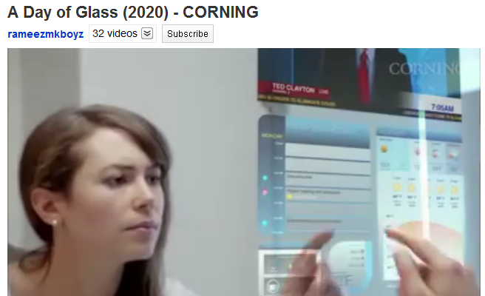
Personal Life
Corning Day of Glass

Slide 3
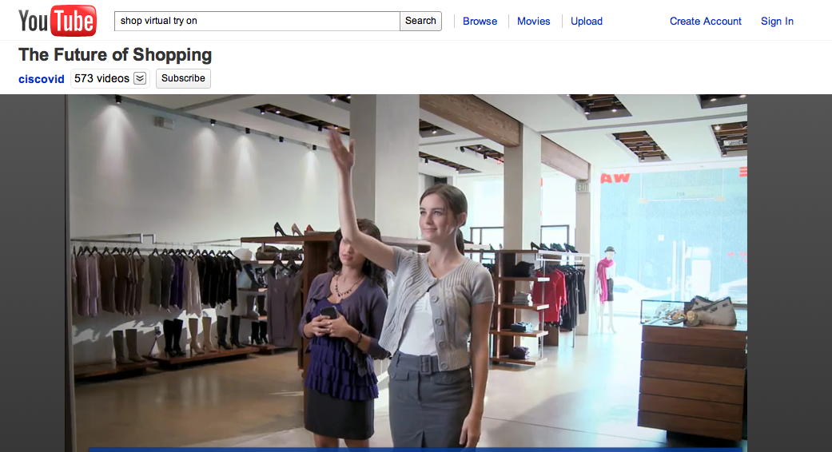
Fashion Designer
The Future of Shopping

Slide 4
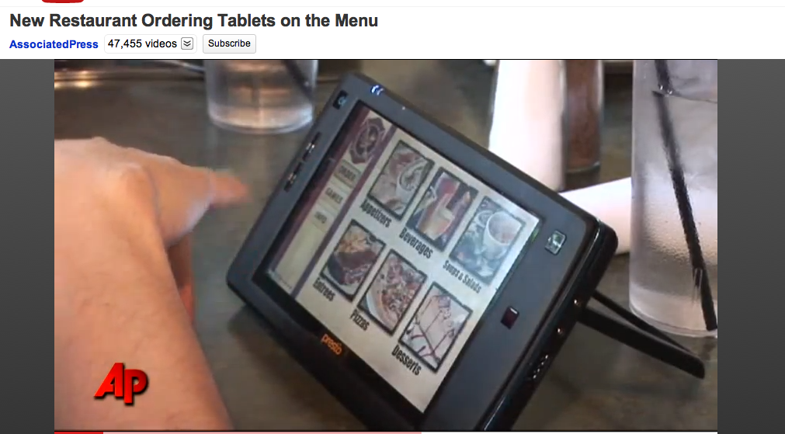
Hospitality
New Restaurant Ordering Tablets on the Menu

Slide 5
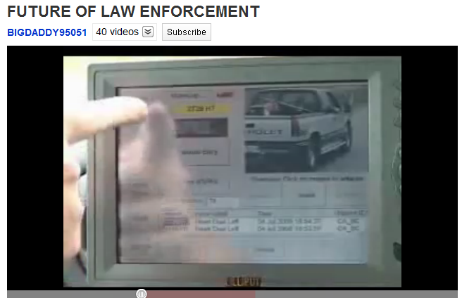
Law Enforcement
Future of Law Enforcement

